Slide 1
Dishcovery
Concept Video
Culture through Cuisine
Defne Genç, Janet Zhong,
Amrita Palaparthi, Kyla Guru
Notes:
Space Grotesk
Anaheim
Barlow Semi-Condensed Normal

Slide 2

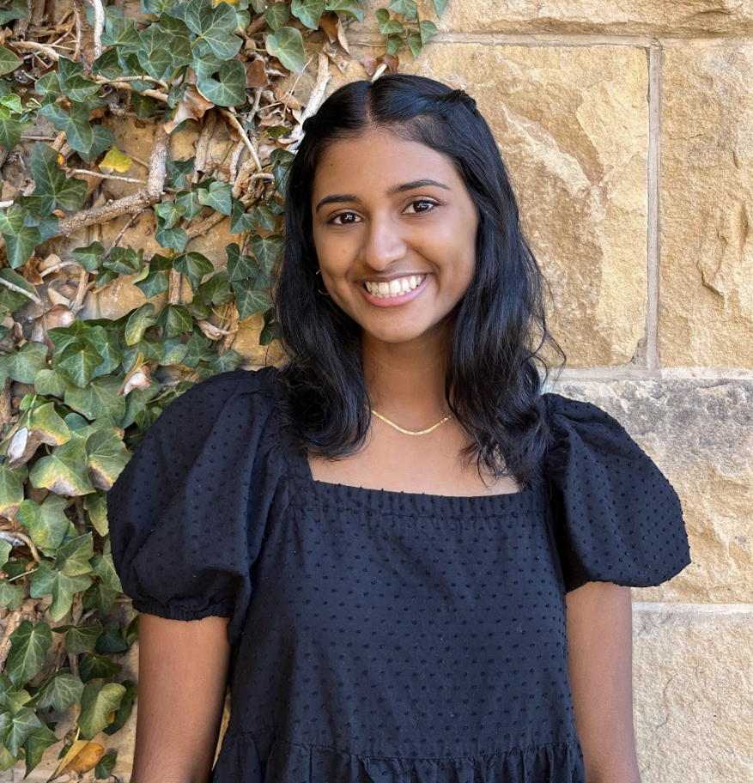
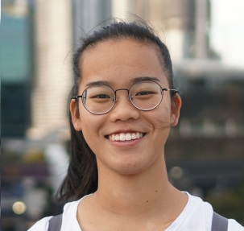

Our PotLuck
Defne
Kyla
Janet
Amrita
Potluck item:
Potluck item:
Potluck item:
Potluck item:
Notes:
Spanning across India, Turkey, Australia

Slide 3
Dishcovery
Recap
Last week, we used experience prototypes to test key assumptions about how people interact with culture through food and began defining a solution. This week, we focus on creating a concept video to further define what our solution offers.

Slide 4
Dishcovery
How might we…
make it so that unfamiliar ingredients speak for themselves?
Notes:
See first slide of appendix for all HMWs for this POV. These are also listed below:
HMW present recipes in the cultural or historical context and personal stories associated with them?
HMW help people share the personal and cultural meaning of their food with others so that they can understand and appreciate them?
HMW connect food with specific memories and shared experiences?
HMW make the process of cooking a more complicated meal for oneself feel worthwhile?
HMW make Martin seek out the story behind what he’s eating?
HMW make food from another culture feel like one’s own?
HMW reduce the friction in reading about different recipes and cultures?
HMW motivate people to research food from different cultures?
HMW make “foregin” food feel like home?
HMW make cooking feel more personal and less transactional for Martin?
HMW use practicality to create passion?

Slide 5
Dishcovery
Table of Contents
Our Solution
The problem we choose to focus on and our value proposition
Market Research
Our competitive landscape and differentiating features
Values in Design
Our approach to ethical challenges that arise in creating our solution
Concept Video Journey
The process of creating our concept video, including task definitions, storyboards, and the final video

Slide 6

Dishcovery
Dishcovery
your cultural culinary companion.

Slide 7
Dishcovery
Unpacking the Name
+
=
Dishcovery
Dish
Discovery
Foreign Ingredients and snacks from a variety of cultures
Understanding cultural context and authentic cooking with unfamiliar foods

Slide 8
Dishcovery
Problem
Learning about and creating food with ingredients from other cultures can be an intimidating experience.

Slide 9
Dishcovery
Our Solution
Dishcovery helps you recognize, learn about, and cook with foods from around the world. We use image recognition to identify new ingredients and enable you to delve into their cultural context and authentic recipes using them, providing a is a cultural culinary companion from the grocery store to your kitchen.

Slide 10
Dishcovery
Market Research - Competitors
우리의식탁 - 요리를 스타일하다
Calorie Mama
Weee!
Shopwell
Universal Yums
Authentic Korean Cooking
Food identification for nutrition
Asian and Hispanic Grocery Delivery
Grocery shopping assistant app
Subscription box for exploring international foods

Slide 11
Dishcovery
Market Research: 우리의식탁 - 요리를 스타일하다
Description: An authentic Korean cooking app, where users can ask questions about dishes for expert cooks to answer
Positive Aspects:
Focus on cultural authenticity
Aesthetic and intuitive UI
Expert testimonials to ensure quality suggestions
Dishcovery differentiators:
Includes information about a variety of cultures rather than just one
Provides context for users from the grocery store to the kitchen, providing additional color and background on ingredients themselves in addition to just recipes
Notes:
Takes pride in his ability to notice delicious food options

Slide 12
Dishcovery
Market Research: Calorie Mama
Description: A food identification system based in image recognition that tracks nutrition information
Positive Aspects:
Automatically performs identification from photos using AI image recognition
Takes pride in the cultural diversity of its food database
Food AI API continually improves in accuracy with the addition of new images
Dishcovery differentiators:
Image recognition is used with an emphasis on cultural information and context rather than primarily nutritional data
Enables users to take further steps once an ingredient or snack item has been scanned, including creating recipes with this item
Notes:
Takes pride in his ability to notice delicious food options

Slide 13
Dishcovery
Market Research: Weee!
Description: an online grocery store delivery service primarily offering Asian and Hispanic cultural food items
Positive Aspects:
Places emphasis on cultural appreciation via events and notifications within the app (e.g. “It’s Filipino week, try these…”)
Wide selection of traditional ingredients
Shared customer testimonials about their experiences with purchased food items
Dishcovery differentiators:
Concentrates on learning about and understanding food items rather than providing a platform to purchase them
Offers information on ingredients around the world instead of within particular regions
Provides a knowledge base and “cultural culinary companion” while they shop for groceries
Notes:
Takes pride in his ability to notice delicious food options

Slide 14
Dishcovery
Market Research: Shopwell
Description: A grocery shopping app that gives users a personalized score and recommendations based on their dietary restrictions and suggests better options based on their dietary profiles
Positive Aspects:
Positive reviews regarding food accessibility
Intelligent suggestions related to nutrition
Location awareness to find products in your local grocery store
Dishcovery differentiators:
Provides a similar grocery store app companion, but one focused on culture rather than nutrition and dietary restrictions
Uses image recognition to identify unlabeled foods rather than only using barcode scanning → enables use in less formal settings like farmers’ markets and community gardens as well as in countries where food is labeled less often
Notes:
Takes pride in his ability to notice delicious food options

Slide 15
Dishcovery
Market Research: Universal Yums
Description: A subscription box that sends curated snacks from different countries to your home each month
Positive Aspects:
Encourages users to try new foreign foods from around the world
Gamified experience makes exploring new cuisines fun
Our differentiators:
Universal Yums is an indirect competitor who shares our mission of encouraging individuals to explore and understand foreign foods, but takes a very different approach to doing so (i.e. sending food to users’ homes)
We instead aim to help users incorporate foreign foods into their daily lives as they shop, cook, and share their food with friends and family
Notes:
Takes pride in his ability to notice delicious food options

Slide 16
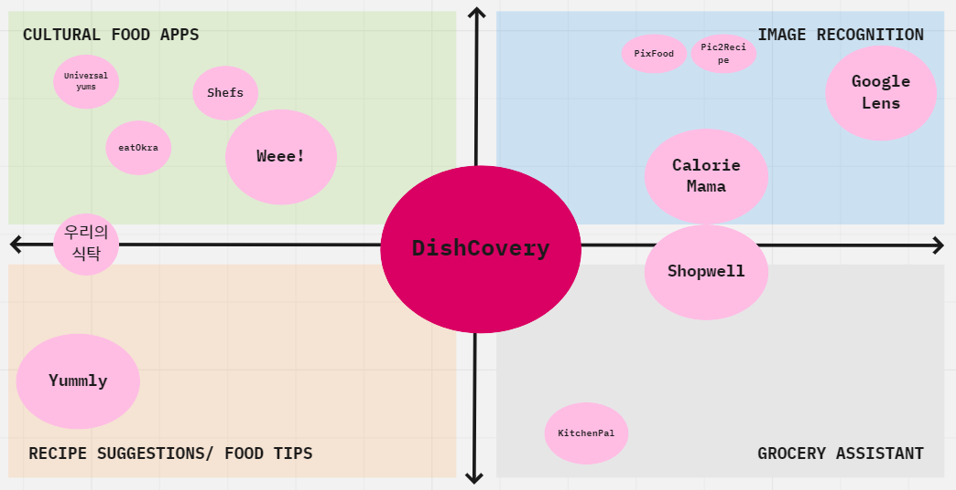
Dishcovery
Competitive Landscape
Notes:
To edit, see Miro

Slide 17
Dishcovery
Values in Design
Accuracy and Authenticity
We source cultural background and geographical food journey map information from reputable, accurate sources
We include Verification (similar to Twitter) for recipe creators and cultural experts
Ethical Cultural Representation
We want to prevent bias in selecting recipes or identifiable ingredients towards or against any culture
We take a crowdsourcing approach to recipes, so all who would like to share their cultural foods and personal stories associated with them are welcome on our platform
Accessibility
Though food identification through our app primarily relies on image recognition, we provide alternate methods of searching for ingredients by name to facilitate inclusion for users who cannot levera
Ethical Use of Data
We do not store or track any data beyond what is strictly necessary for the app to function (e.g. scanned items, recipes currently in use)
Notes:
Takes pride in his ability to notice delicious food options

Slide 18
Dishcovery
Task 1: Identification
Description: I want to automatically identify an unfamiliar food item
Category: Simple
Explanation: Naming and identifying ingredients or snacks is a crucial first step necessary before users can gain further understanding of cultural foods

Slide 19
Dishcovery
Task 2: Contextualization
Description: I want to learn more about the cultural context behind a food item and its uses in recipes
Category: Moderate
Explanation: This task draws users who want to take the next step to dive deeper into a food’s cultural and personal background as well as authentic use cases

Slide 20
Dishcovery
Task 3: Authentic Cooking
Description: I want to cook a cultural authentic dish with a new ingredient
Category: Complex
Explanation: This task appeals to power users who not only want to gain a deeper understanding of global foods, but also put this new knowledge into practice by learning to cook a foreign dish themselves

Slide 21
Dishcovery
Task 4: Sharing
Description: I want to share my discovery of new foods with others
Category: Moderate
Explanation: After learning about a new food item, users can then experience the uniquely collaborative experience of understanding, creating, and partaking in cultural food with friends and family

Slide 22
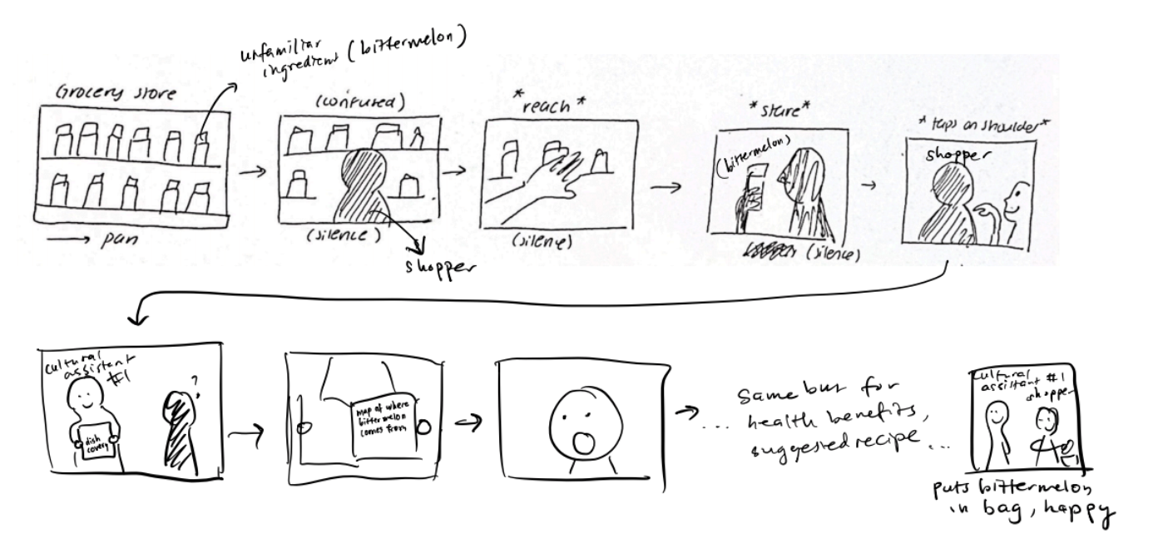
Dishcovery
Video Storyboards
Location: Grocery store
Task (1-2)
Notes:
Takes pride in his ability to notice delicious food options

Slide 23
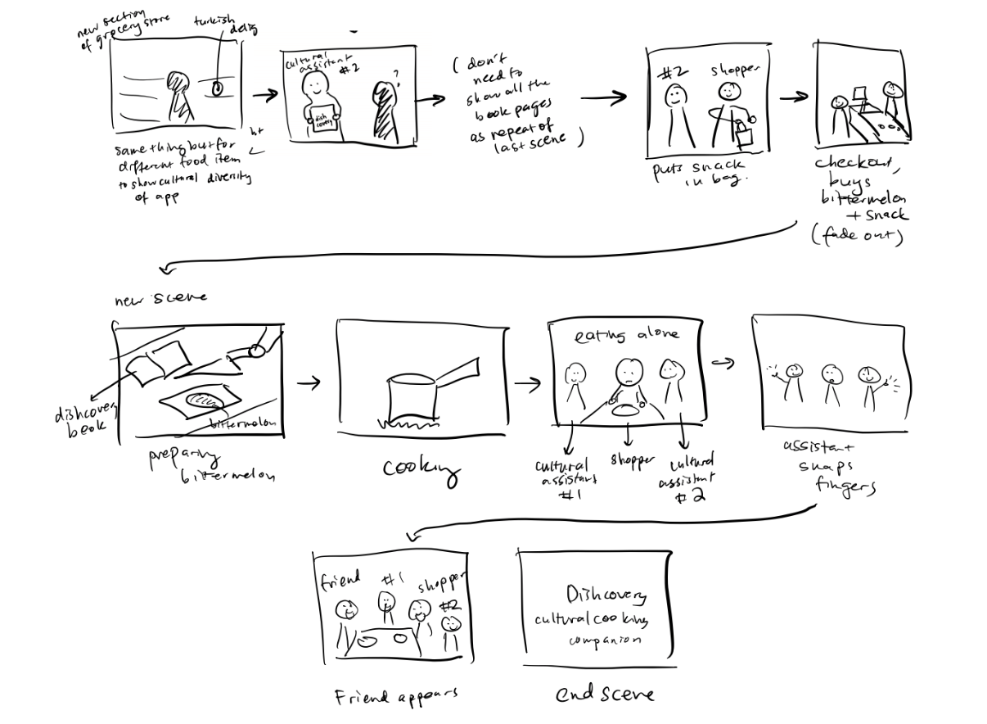
Dishcovery
Location: Grocery store
Notes:
Takes pride in his ability to notice delicious food options

Slide 24
Dishcovery
Location: kitchen/ living room
Task 3
Task 4
Notes:
Takes pride in his ability to notice delicious food options

Slide 25
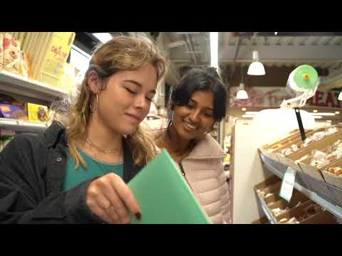
Team PotLuck
Concept Video
https://youtu.be/S4b0E7TwgTA

Slide 26
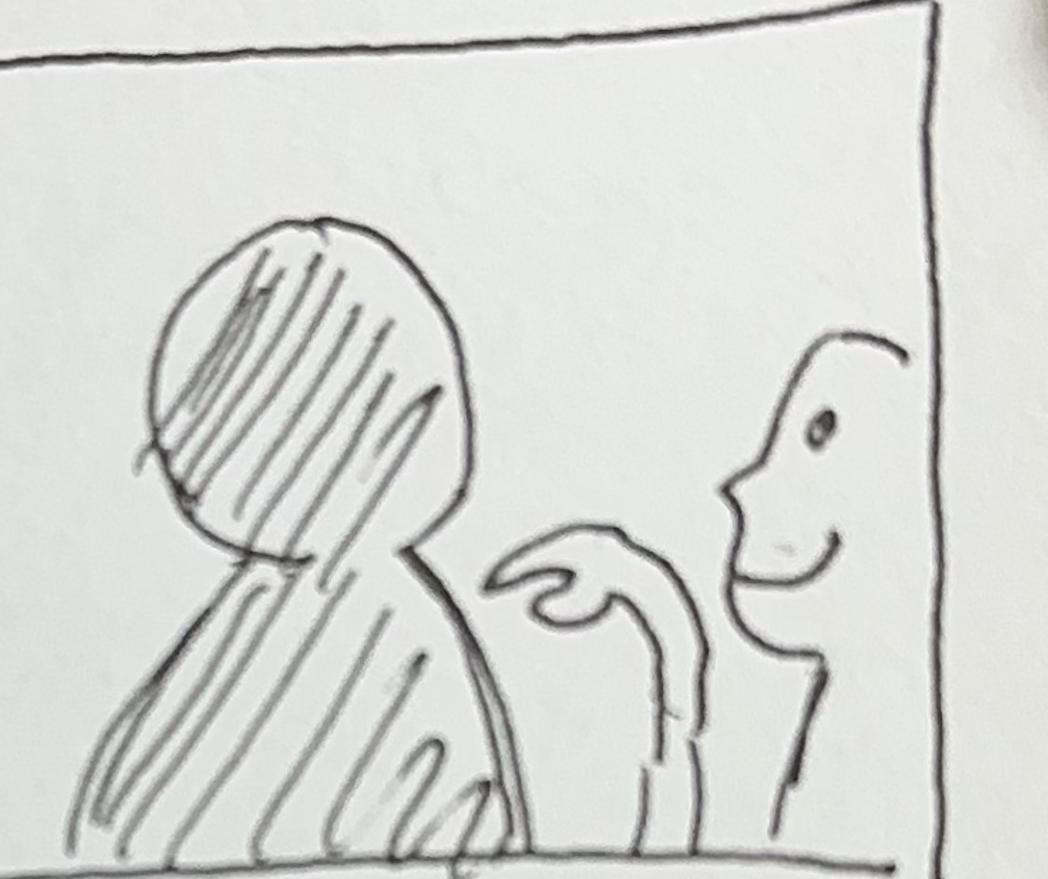
Appendix
Thanks for watching!

Slide 27
Dishcovery
Ingredient identification

Slide 28
Dishcovery
Find authentic recipes

Slide 29
Dishcovery
Your cultural culinary companion

